Slide 1
CS4225/CS5425 Big Data Systems for Data Science
Tutorial 4: Streaming and Graphs
Answers

Slide 2
Question 1
In Spark Structured Streaming, why we need to specify a checkpoint location?
Answer: to save the progress information of a stream query, i.e. what data has been successfully processed. Upon failure, this info is used to restart the failed query exactly where it left off.

Slide 3
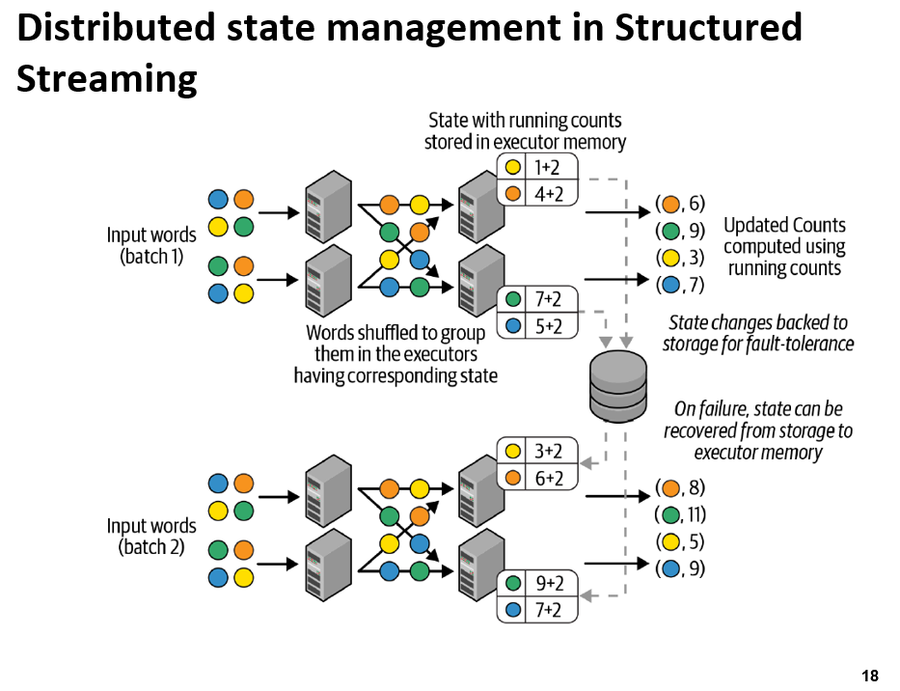
Each micro-batch
Reads a new set of words
Shuffles them within the executors to group them
Computes the counts within the micro-batch
Adds them to the running counts to produce the new counts
Output
State for the next micro-batch
Cached in the memory of the executors.
Synchronously save the key/value state update as change logs in the checkpoint location provided by the user.
Lecture 8: Slide 18

Slide 4
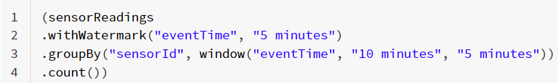
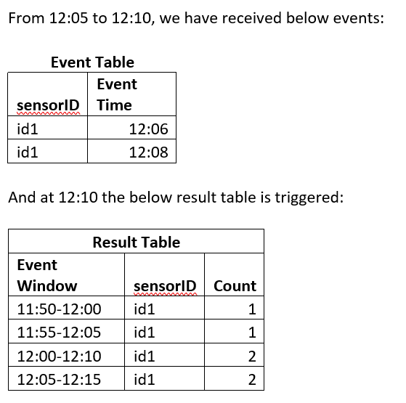
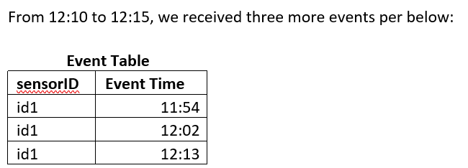
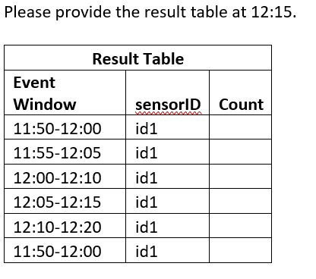
Question 2
In Spark Structured Streaming, we are using below codes to collect the streaming data from sensor readings.

Slide 5
From 12:05 – 12:10
Result Table (12:10)
SensorID | Event Time
Id1 | 12:06
Id1 | 12:08
Event Window | SensorID | Count
11:50-12:00 | 1 | 1
11:55-12:05 | 1 | 1
12:00-12:10 | 1 | 2
12:05-12:15 | 1 | 2
From earlier processing time
12:20
12:15
12:10
12:05
12:00
11:55
11:50
Event Time
12:08
12:08 – 5min
12:06
WM: 12:03
11:50 11:55 12:00 12:05 12:10 12:15 12:20
Processing Time with 5 min trigger

Slide 6
From 12:05 – 12:10
From 12:10 – 12:15
Result Table (12:15)
SensorID | Event Time
Id1 | 12:06
Id1 | 12:08
Event Window | SensorID | Count
11:50-12:00 | 1 | 1
11:55-12:05 | 1 | 1
12:00-12:10 | 1 | 2
12:05-12:15 | 1 | 2
12:10-12:20
SensorID | Event Time
Id1 | 11:54
Id1 | 12:02
Id1 | 12:13
2
3
3
1
1
12:20
12:15
12:10
12:05
12:00
11:55
11:50
Event Time
12:13
12:13 – 5min
WM: 12:08
12:08
12:08 – 5min
12:06
WM: 12:03
12:02
11:54
11:54
11:50 11:55 12:00 12:05 12:10 12:15 12:20
Processing Time with 5 min trigger

Slide 7
Answer 2
Event Window | SensorID | Count
11:50-12:00 | 1 | 1
11:55-12:05 | 1 | 2
12:00-12:10 | 1 | 3
12:05-12:15 | 1 | 3
12:10-12:20 | 1 | 1
Watermark = max event time (before 12:10) – watermark delay = 12:08 – 5 min = 12:03
Therefore, intermediate state for 11:50-12:00 is dropped as watermark (12:03) > 12:00. The 11:50-12:00 entry will not be updated, and the rest entries are updated accordingly.
Note: the intermediate state 11:55-12:05 is NOT dropped as watermark (12:03) < 12:05, there may still be events from 12:03 to 12:05, need to be recorded. Though later, an event 12: 02 (< watermark 12:03) show up, since this entry (11:55 – 12:05) is still active we will record the 12:02 event under this entry (11:55 – 12:05) accordingly.

Slide 8
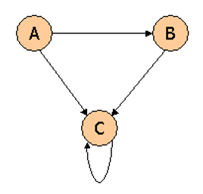
Question 3
Consider three Web pages with the following links:
Suppose we compute PageRank with a β of 0.7 (note: we assume that the sum of the PageRanks of the three pages must be 1, to handle the problem that otherwise any multiple of a solution will also be a solution). Compute the PageRanks a, b, and c of the three pages A, B, and C, respectively.

Slide 9
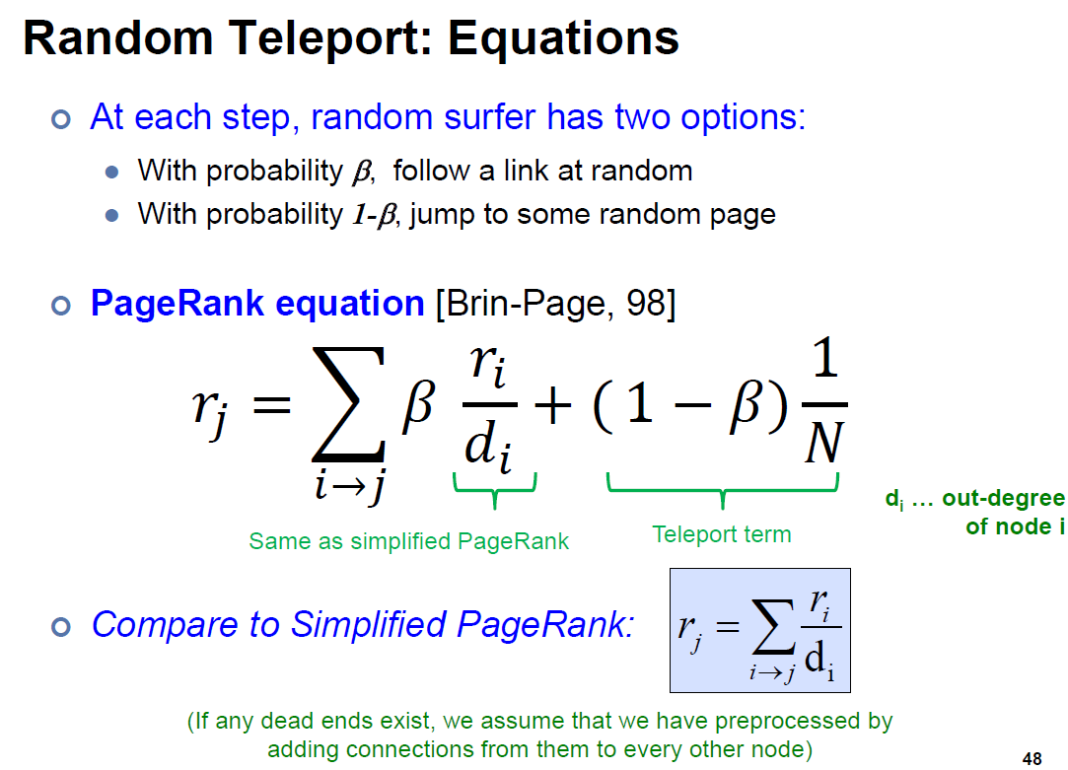
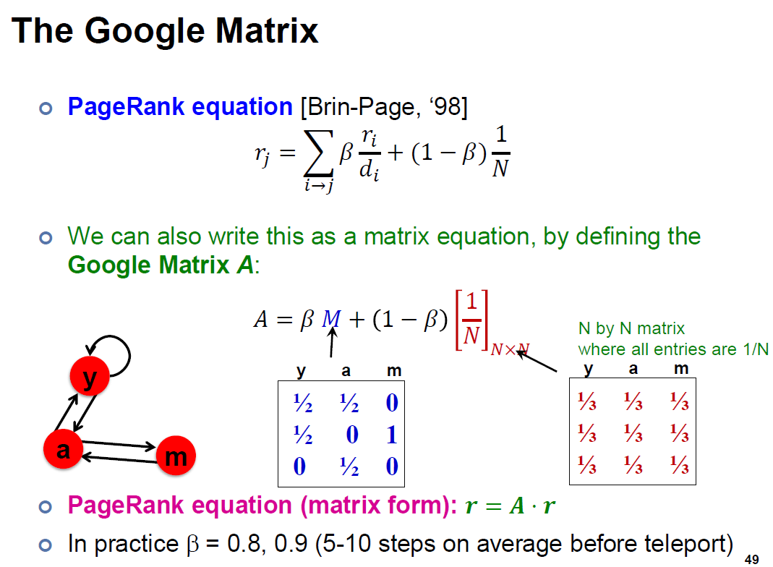
Lecture 9: Slide 48
Lecture 9: Slide 49

Slide 10
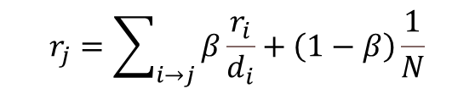

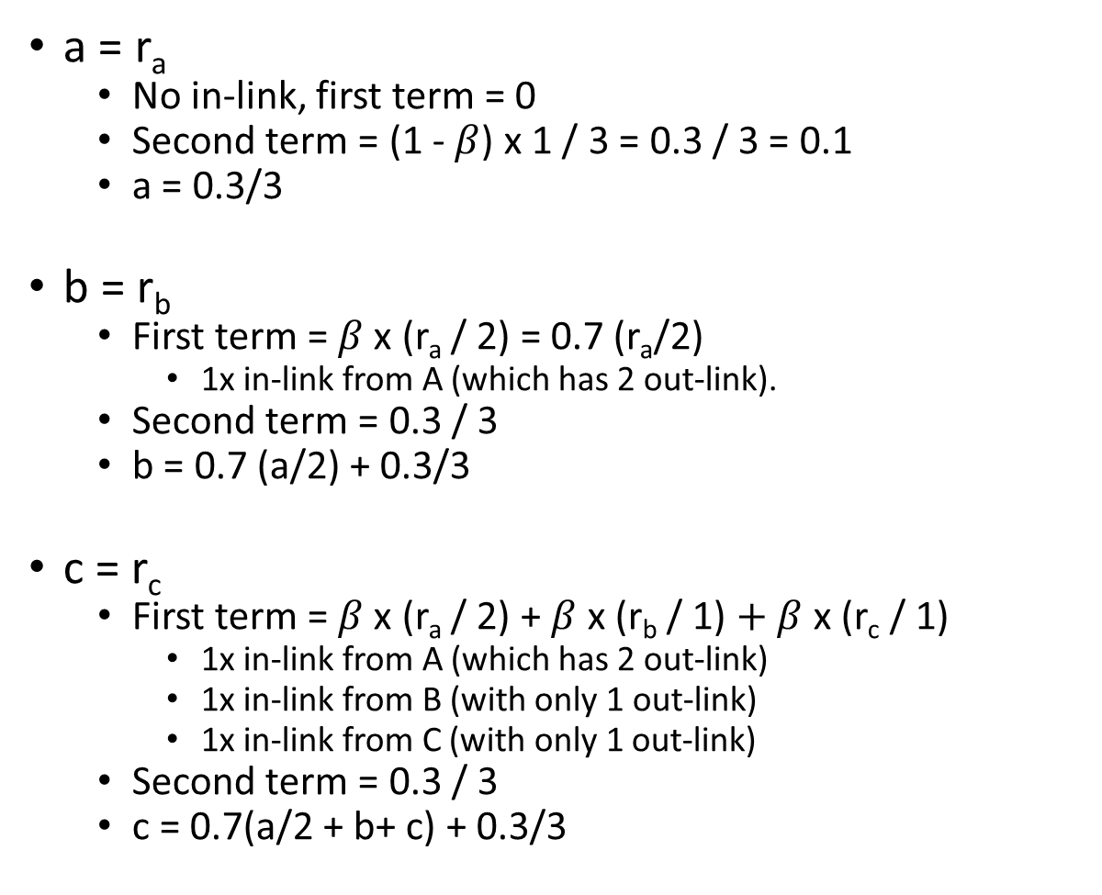
a = r_{a}
No in-link, first term = 0
Second term = (1 - $β$) x 1 / 3 = 0.3 / 3 = 0.1
a = 0.3/3
b = r_{b}
First term = $β$ x (r_{a} / 2) = 0.7 (r_{a}/2)
1x in-link from A (which has 2 out-link).
Second term = 0.3 / 3
b = 0.7 (a/2) + 0.3/3
c = r_{c}
First term = $β$ x (r_{a} / 2) + $β$ x (r_{b} / 1) $+ β$ x (r_{c} / 1)
1x in-link from A (which has 2 out-link)
1x in-link from B (with only 1 out-link)
1x in-link from C (with only 1 out-link)
Second term = 0.3 / 3
c = 0.7(a/2 + b+ c) + 0.3/3
$$r_{j}=\sum_{i→j}{β\frac{r_{i}}{d_{i}}}+\left(1−β\right)\frac{1}{N}$$
$β$ = 0.7

Slide 11
a = 0.3/3 b = 0.7(a/2) + 0.3/3 c = 0.7(a/2+b+c) + 0.3/3
You can understand this term by term: the 0.3/3 comes from the teleport probability of 0.3, which is divided among 3 nodes since it randomly chooses which node to teleport to.
For the other terms like 0.7(a/2), note that a splits its PageRank between b and c, while b gives all of its to c, and c keeps all its own. However, all PageRank is multiplied by 0.7 before being sent, as the probability of taking regular steps (i.e. non-teleport) is 0.7.
Solving the equations: we get a = 0.1. Then, the 2nd equation gives b = 0.7*0.1/2 + 0.1 = 0.135. Finally, since the 3 weights sum up to 1, the remaining weight of 1 – 0.1 – 0.135 = 0.765 must lie with node c (you can check that this also satisfies the last equation).
$$r_{j}=\sum_{i→j}{β\frac{r_{i}}{d_{i}}}+\left(1−β\right)\frac{1}{N}$$
$β$ = 0.7

Slide 12
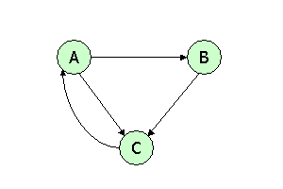
Question 4
Consider three Web pages with the following links:
Suppose we compute PageRank with a β of 0.85. Write the equations for the PageRanks a, b and c of the three pages A, B and C, respectively.

Slide 13
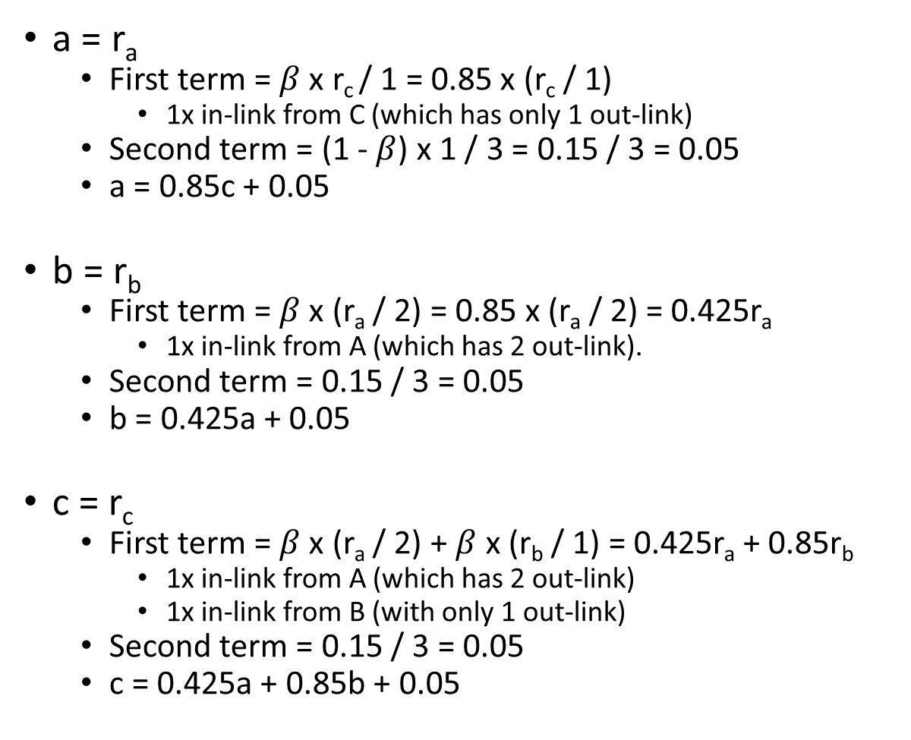

a = r_{a}
First term = $β$ x r_{c} / 1 = 0.85 x (r_{c} / 1)
1x in-link from C (which has only 1 out-link)
Second term = (1 - $β$) x 1 / 3 = 0.15 / 3 = 0.05
a = 0.85c + 0.05
b = r_{b}
First term = $β$ x (r_{a} / 2) = 0.85 x (r_{a} / 2) = 0.425r_{a}
1x in-link from A (which has 2 out-link).
Second term = 0.15 / 3 = 0.05
b = 0.425a + 0.05
c = r_{c}
First term = $β$ x (r_{a} / 2) + $β$ x (r_{b} / 1) = 0.425r_{a} + 0.85r_{b}
1x in-link from A (which has 2 out-link)
1x in-link from B (with only 1 out-link)
Second term = 0.15 / 3 = 0.05
c = 0.425a + 0.85b + 0.05
$$r_{j}=\sum_{i→j}{β\frac{r_{i}}{d_{i}}}+\left(1−β\right)\frac{1}{N}$$
$β$ = 0.85

Slide 14
a = 0.85c + 0.05 b = 0.425a + 0.05
c = 0.425a + 0.85b + 0.05
(i.e. every node receives 0.15 / 3 = 0.05 teleport probability, and a receives all the pagerank from c; b receives half the pagerank from a, and c receives all the pagerank from b and half from a, before applying the teleport probability).
Note that if the question doesn’t ask to solve the equations, you don’t have to solve them.
$$r_{j}=\sum_{i→j}{β\frac{r_{i}}{d_{i}}}+\left(1−β\right)\frac{1}{N}$$
$β$ = 0.85

Slide 15
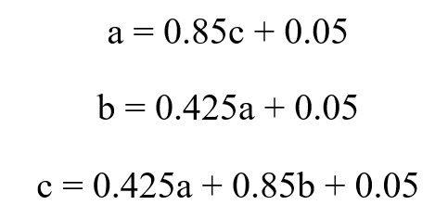
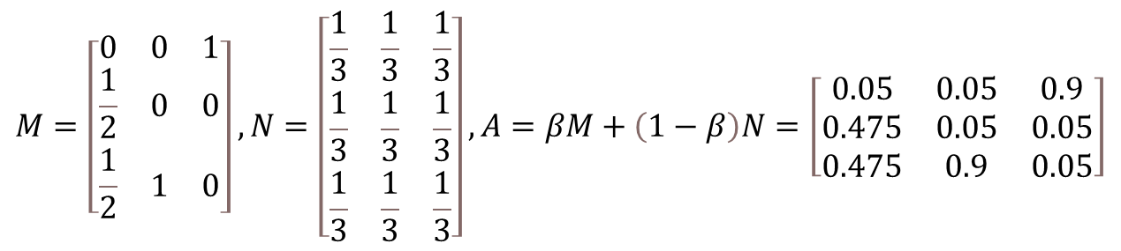
Also note that it is also fine to use the matrix form of the PageRank equations:
$$M=\left[\begin{matrix}0 & 0 & 1 \\ \frac{1}{2} & 0 & 0 \\ \frac{1}{2} & 1 & 0\end{matrix}\right], N=\left[\begin{matrix}\frac{1}{3} & \frac{1}{3} & \frac{1}{3} \\ \frac{1}{3} & \frac{1}{3} & \frac{1}{3} \\ \frac{1}{3} & \frac{1}{3} & \frac{1}{3}\end{matrix}\right], A=βM+\left(1−β\right)N=\left[\begin{matrix}0.05 & 0.05 & 0.9 \\ 0.475 & 0.05 & 0.05 \\ 0.475 & 0.9 & 0.05\end{matrix}\right]$$
The PageRank equation is then r=Ar, where r is PageRank, which could also be written as:
a=0.05a+0.05b+0.9c
b=0.475a+0.05b+0.05c
c=0.475a+0.9b+0.05c
Note that these are equivalent to the equations in the 1st solution (so both are correct answers), since a+b+c=1.

